Slide 1

Phase 4
Market Basket insights
Team members:
Nivya shaji
Aleena Suresh
Abira S
Anushya L
BUSINESS
REPORT PERSON
THE NAME OF THE COMPANY
TEMPLATE

Slide 2
What is a CMS market basket?
Although “market basket” technically describes the mix of goods and services used in providing health
care, this term is also commonly used to denote the input price index (that is, cost category weights and
price proxies combined) derived from that market basket. Accordingly, the term “market basket” as
used in this document refers to the various CMS input price indexes. A CMS market basket is described
as a fixed-weight, Laspeyres-type index because it measures the change in price, over time, of the same
mix of goods and services purchased in the base period.
CONTENTS

Slide 3
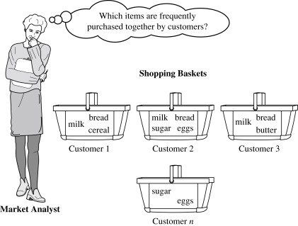

Slide 4
Types of Market Basket Analysis
Market basket analysis is classified into two types:
Predictive Market Basket Analysis
Differential Market Basket Analysis
Predictive Market Basket Analysis

Slide 5
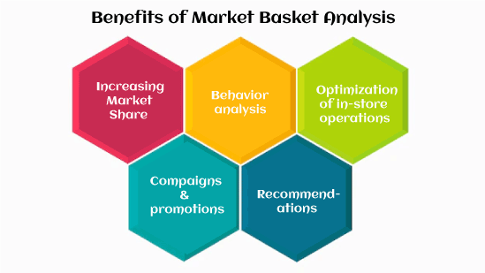

Slide 6
Predictive Market Basket Analysis
Predictive market basket analysis is a type of data mining technique that uses historical data on customer purchases to make predictions about future customer behavior. The goal of predictive market basket analysis is to identify items that are likely to be purchased together and use this information to inform business decisions such as product placement, marketing strategies, and inventory management.

Slide 7
Differential Market Basket Analysis
Differential Market Basket Analysis (DMBA) is a statistical technique used to identify the difference between two or more market baskets, or sets of items, typically purchased together by customers. It is commonly used in retail and marketing to understand the purchasing behavior of customers, as well as to identify trends and patterns in sales data. The goal of DMBA is to find items that are unique to each market basket and determine the associations between them, which can then be used to inform promotional strategies, product placement, and other marketing decisions.

Slide 8
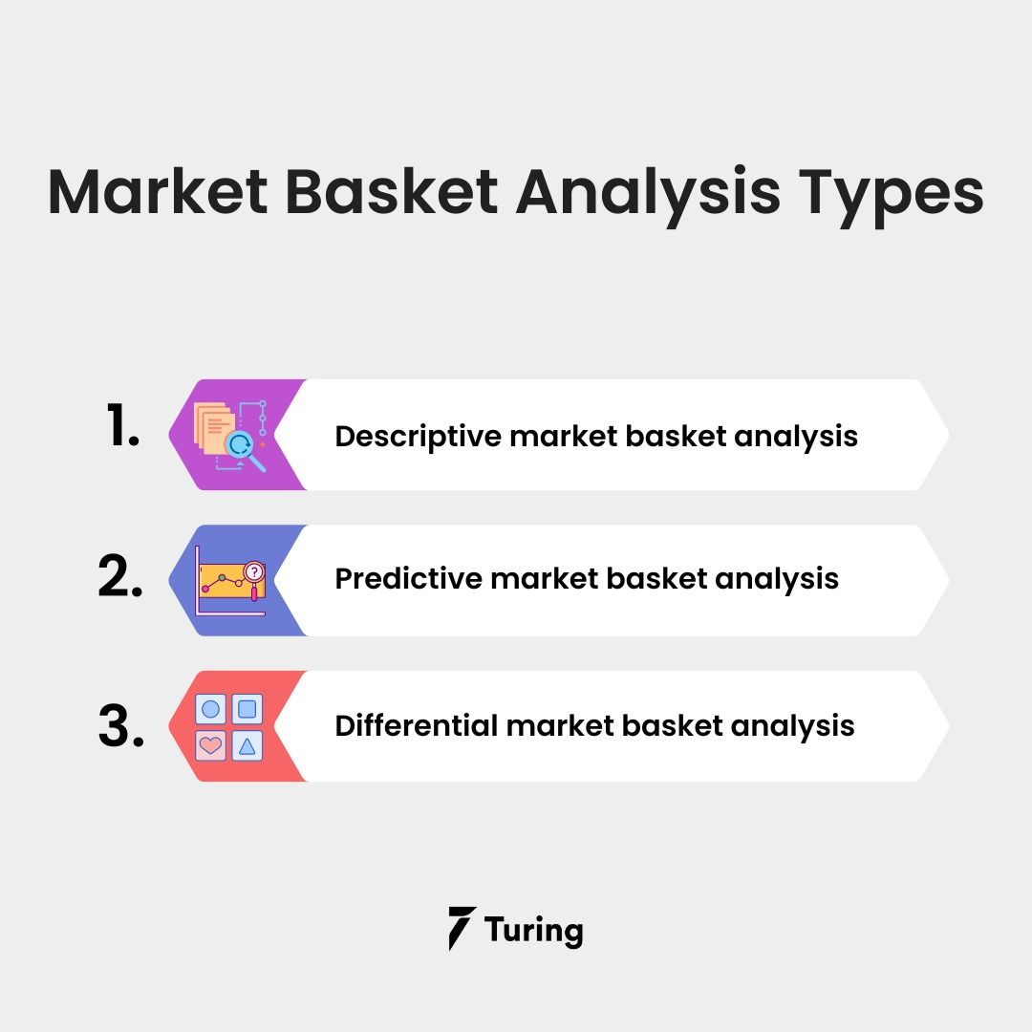

Slide 9
The Retail Industry
Market basket research can assist retailers to find goods that are commonly purchased together, which can help them make product placement, marketing, and price decision
Applications of Market Basket Analysis
The Retail Industry
Market basket research can assist retailers to find goods that are commonly purchased together, which can help them make product placement, marketing, and price decision
Financial Services and Banking
Market basket analysis can be used by banks and financial organizations to evaluate client data and uncover trends in their purchasing habits.

Slide 10
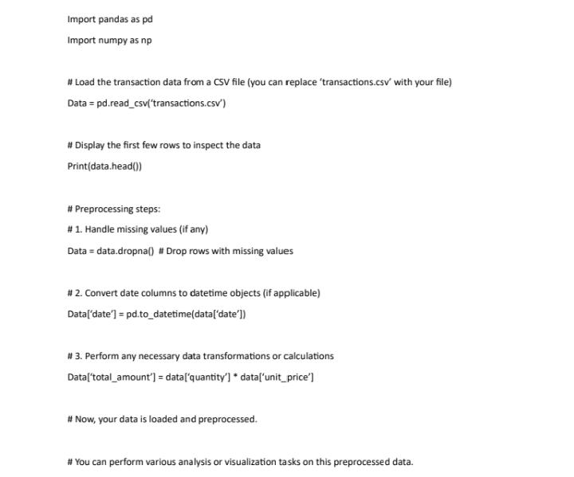

Slide 11
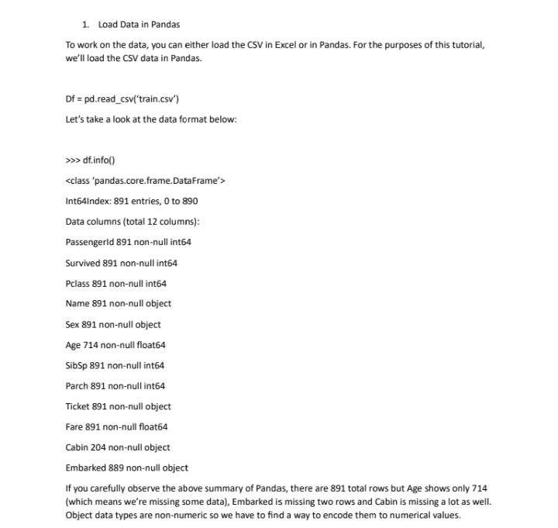

Slide 12
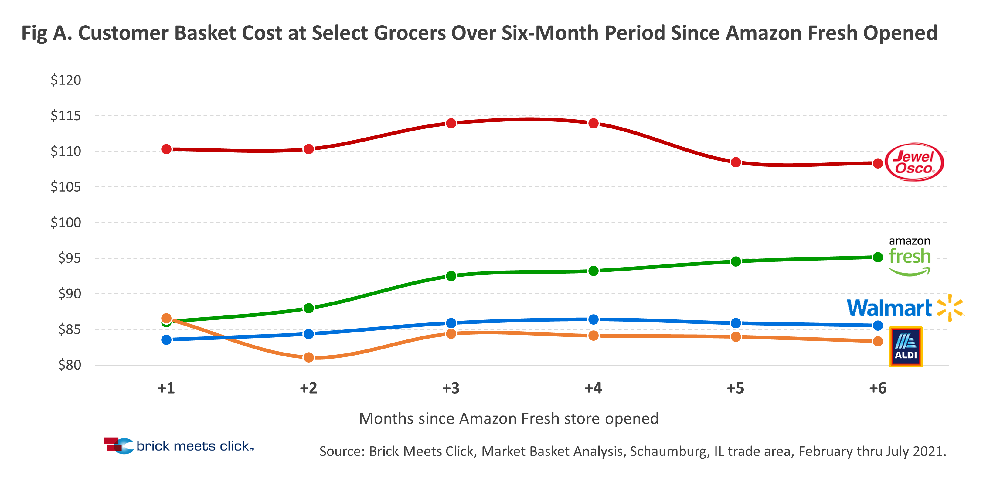

Slide 13
How Does Market Basket Analysis Work?
Collect data on customer transactions, such as the items purchased in each transaction, the time and date of the transaction, and any other relevant information.
Clean and preprocess the data, removing any irrelevant information, handling missing values, and converting the data into a suitable format for analysis.

Slide 14
Algorithms Used in Market Basket Analysis
There are multiple data mining techniques and algorithms used in Market Basket Analysis. One of the important objectives is “to predict the probability of items that are being bought together by customers.”
Apriori Algorithm
AIS
SETM Algorithm
FP Growth

Slide 15
Advantages of Market Basket Analysis
There are many advantages to implementing Market Basket Analysis in marketing. Market Basket Analysis (MBA) can be applied to data of customers from the point of sale (PoS) systems.
It helps retailers in the following ways:
Increases customer engagement,
Boosts sales and increases RoI,
Improves customer experience,
Optimizes marketing strategies and campaigns,
Helps in demographic data analysis,
Identifies customer behavior and pattern.

Slide 16
Implementing Market Basket Analysis in Python
The Method
Here are the steps involved in using the apriori algorithm to implement MBA:
First, define the minimum support and confidence for the association rule.
Find out all the subsets in the transactions with higher support(sup) than the minimum support.
Find all the rules for these subsets with higher confidence than minimum confidence.
Sort these association rules in decreasing order.
Analyze the rules along with their confidence and support.

Slide 17
Implementing Market Basket Analysis Using the Apriori Method
The Apriori algorithm is frequently used by data scientists. We are required to import the necessary libraries. Python provides the apyori as an API that is required to be imported to run the Apriori Algorithm.
import pandas as pd
import numpy as np
from apyori import apriori

Slide 18
#converting dataframe into list of lists
l=[]
for i in range(1,7501):
l.append([str(st_df.values[i
for i in range(0, len(association_results)):
print(association_results[i][0])

Slide 19
for item in association_results:
# first index of the inner list
# Contains base item and add item
pair = item[0]
items = [x for x in pair]
print("Rule: " + items[0] + " -> " + items[1])
# second index of the inner list
print("Support: " + str(item[1]))
# third index of the list located at 0th position
# of the third index of the inner list
print("Confidence: " + str(item[2][0][2]))
print("Lift: " + str(item[2][0][3]))
print("--------------

Slide 20
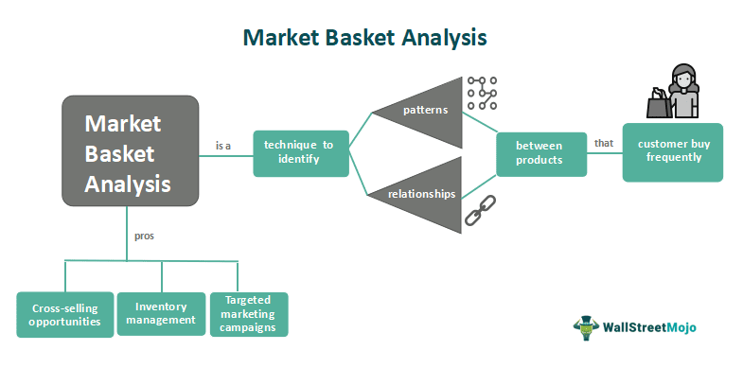

Slide 21
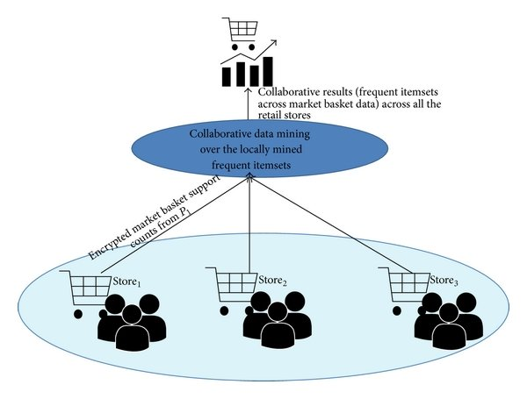

Slide 22
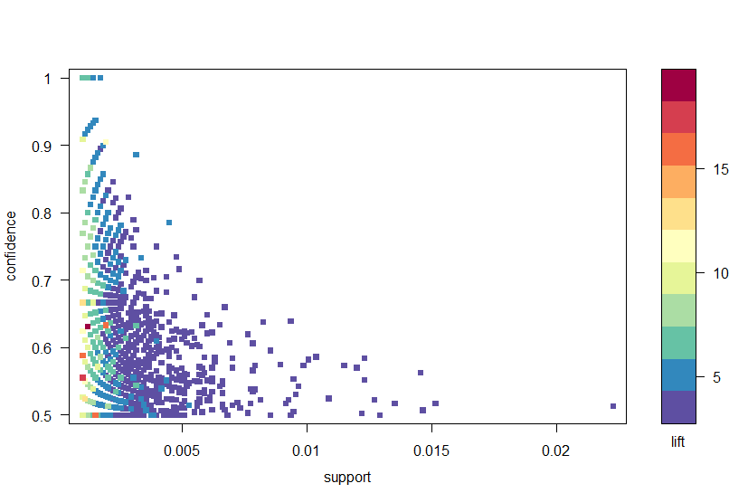

Slide 23


